Slide 1

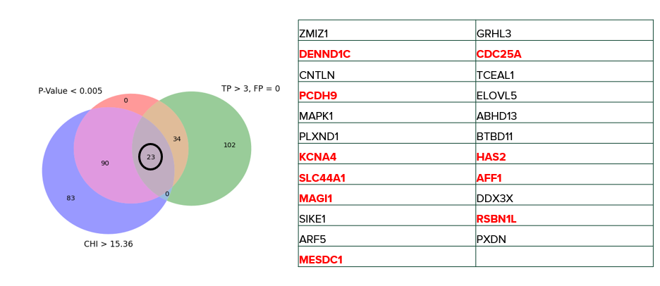
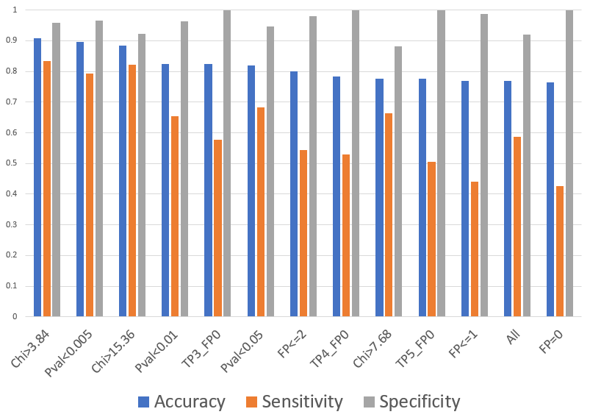
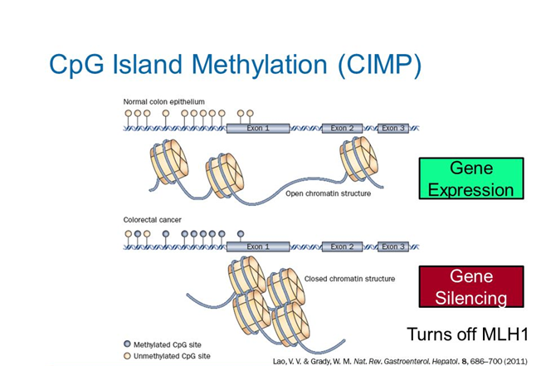
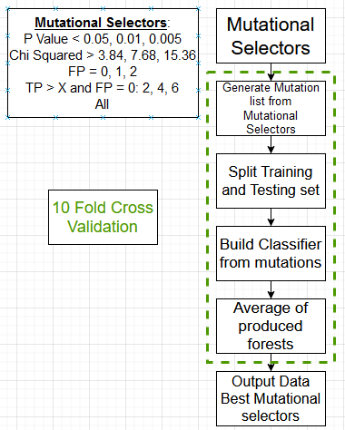
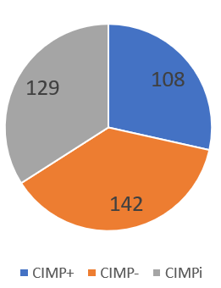
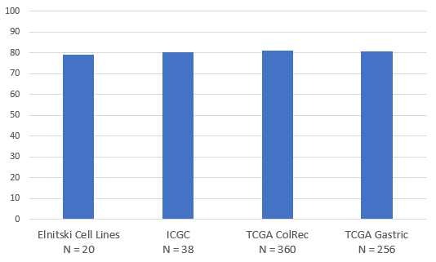
Use of Somatic Mutations for Classification of Endometrial Carcinomas with CpG Island Methylator Phenotype
Jonathan R. Feige, Lonnie R. Welch
Laura Elnitski – National Human Genome Research Institute
Abstract and Introduction
Results
Important Mutations
Our working hypothesis is that DNA mutations in endometrial tumors can be used to predict CIMP. This capability will be useful when DNA methylation data is not available for analysis. Being able to quickly and accurately classify CIMP patients will lead to better diagnostics and therapies.
Figure 1: Some cancers can have extensive gain of DNA methylation resulting in CIMP. There are three subtypes of CIMP: CIMP+, CIMP-, and CIMP intermediate.
Figure 3. Using only these mutations we can classify samples with an accuracy between 100 and 70 precent. We can predict a sample’s CIMP status with up to 90% accuracy.
Figure 4. A validation test was performed on two uterine datasets, colorectal tumors, and gastric tumors. We saw accuracies of 80%.
Figure 5. A Venn Diagram that shows three mutational selectors and their intersection. The mutations in red have an existing relationship to cancer.
Conclusions:
The results from the previous three aims show a strong connection between CIMP and mutations.
We have found a distinct selection of mutations that can accurately separate the CIMP+ cancer samples from the CIMP- samples.
This breakthrough in technology could give us the ability to classify unknown samples, which could lead to improved diagnostics and therapeutics.
Next Steps:
Building classification models that would be able to study CIMP on a pan-cancer scale.
Analyzing the most important mutations identified by the classification model by research into the relationships between CIMP related mutations and biological pathways.
Generating hypotheses for future experiments.
Materials and Methodology
The data is from The Cancer Genome Atlas. The samples retrieved contained both methylation data and mutational data.
Figure 2. The data consists of X unique samples: 108 CIMP+, 142 CIMP-, and X CIMPi. There are 8085 total mutations. Of the 8085 mutations, 149 demonstrated a strong correlation to either the CIMP+ or the CIMP- grouping.
Our goal is to correctly classify tumors as CIMP+ or CIMP- by building a random forest classifier.
Sample distribution
References
The cancer genome atlas program. National Cancer Institute. (n.d.). Retrieved March 15, 2022, from https://www.cancer.gov/about-nci/organization/ccg/research/structural-genomics/tcga
Sánchez-Vega, Francisco, et al. “Pan-Cancer Stratification of Solid HUMAN Epithelial Tumors and Cancer Cell Lines REVEALS Commonalities and Tissue-Specific Features of the CPG ISLAND METHYLATOR PHENOTYPE.” Epigenetics & Chromatin, vol. 8, no. 1, 2015, doi:10.1186/s13072-015-0007-7., https://pubmed.ncbi.nlm.nih.gov/25960768/
Miller, Brendan, et al. (2016) "The Emergence of Pan-Cancer CIMP and Its Elusive Interpretation." Biomolecules, vol. 6, no. 4, 2016, p. 45., doi:10.3390/biom6040045., https://pubmed.ncbi.nlm.nih.gov/27879658/
Kunitomi, Haruko, et al. “New Use of Microsatellite Instability Analysis in Endometrial Cancer.” Oncology Letters, vol. 14, no. 3, 20 July 2017, 10.3892/ol.2017.6640. Accessed 24 Nov. 2020., https://www.ncbi.nlm.nih.gov/pmc/articles/PMC5587995/

